Slide 1
BUSINESS PROBLEM
Turn strong e-commerce activity into a more durable growth engine
Sales performance
Customer behavior
Product and growth
See where momentum is real, seasonal, or at risk of fading.
Understand repeat purchasing, value, and retention opportunities.
Find winning products, leakage, and the next markets to test.
Management question: which parts of the revenue mix can hold beyond the peak, and where should the business act next?

Slide 2
DATA & METHODOLOGY
Move from raw transactions to decisions in five simple steps
Raw data
Clean
Prepare
Analyze
Insights
541,909 records
8 original columns
Remove invalid, cancelled, duplicate, blank, and non-commercial lines.
Standardize fields and create Total Amount = Quantity × Unit Price.
Review sales, orders, customers, products, countries, and cancellations.
Translate patterns into management actions and tests.
Project footprint: 25,900 invoices · 4,070 unique stock codes · 4,223 product descriptions · 38 countries

Slide 3
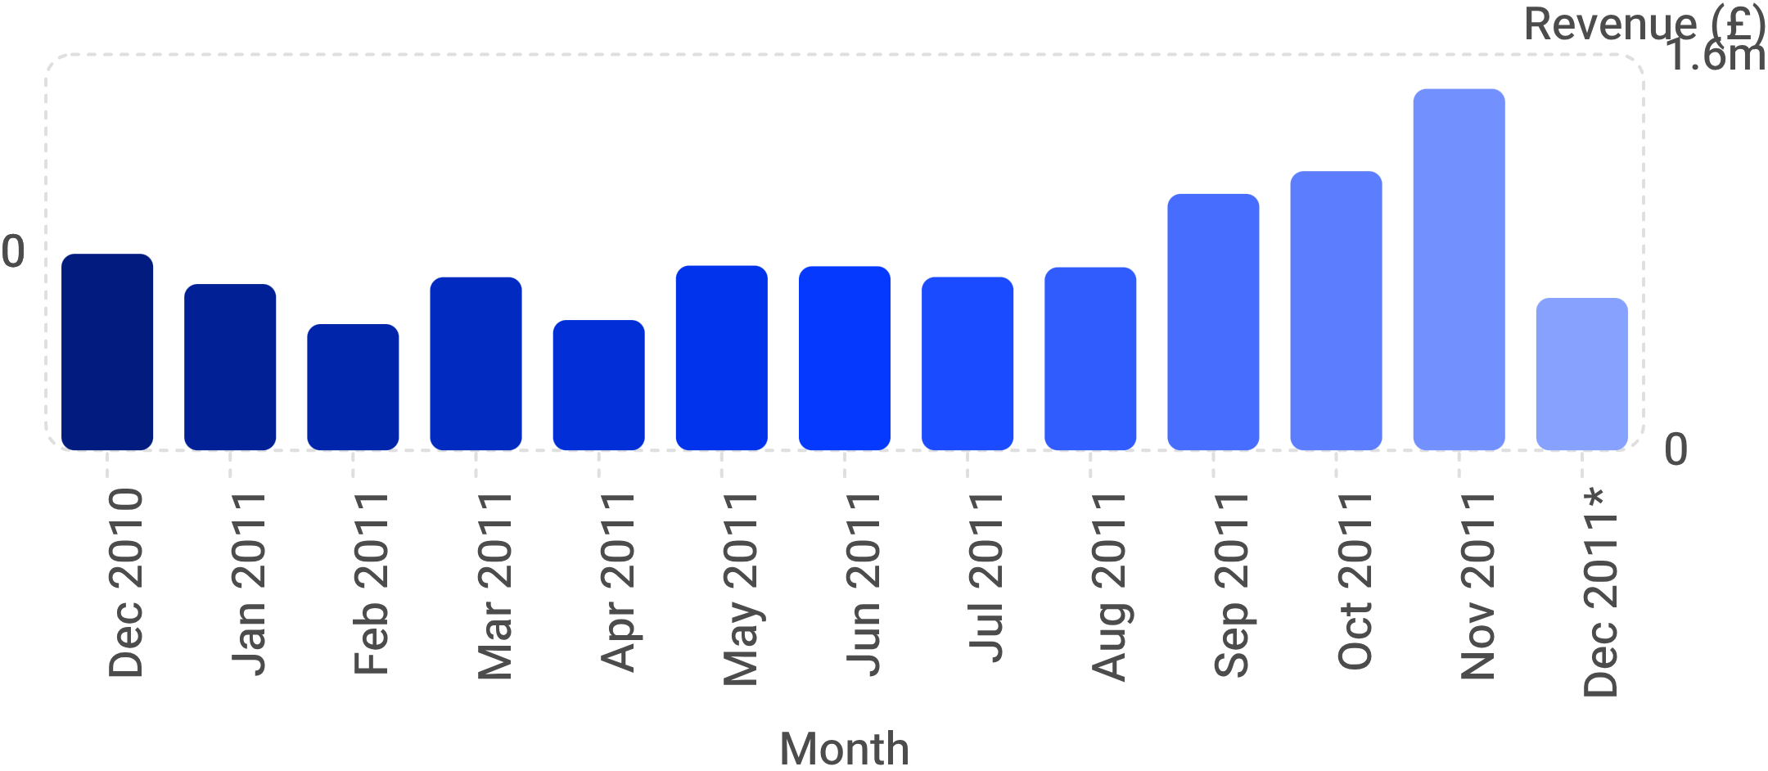
KEY FINDINGS
Growth is visible, but the mix is concentrated and should be managed deliberately
EVIDENCE SNAPSHOT
£8.19M from repeat customers
Repeat customers contributed 92.9% of clean product sales among identified customers.
Geography: UK contributes 84.9%. Product: leading product generated £174K.
Revenue peaks at £1.46M in November; December 2011* is partial.
Use [Top Product] and [Top Country] when a final ranked label is required.

Slide 4
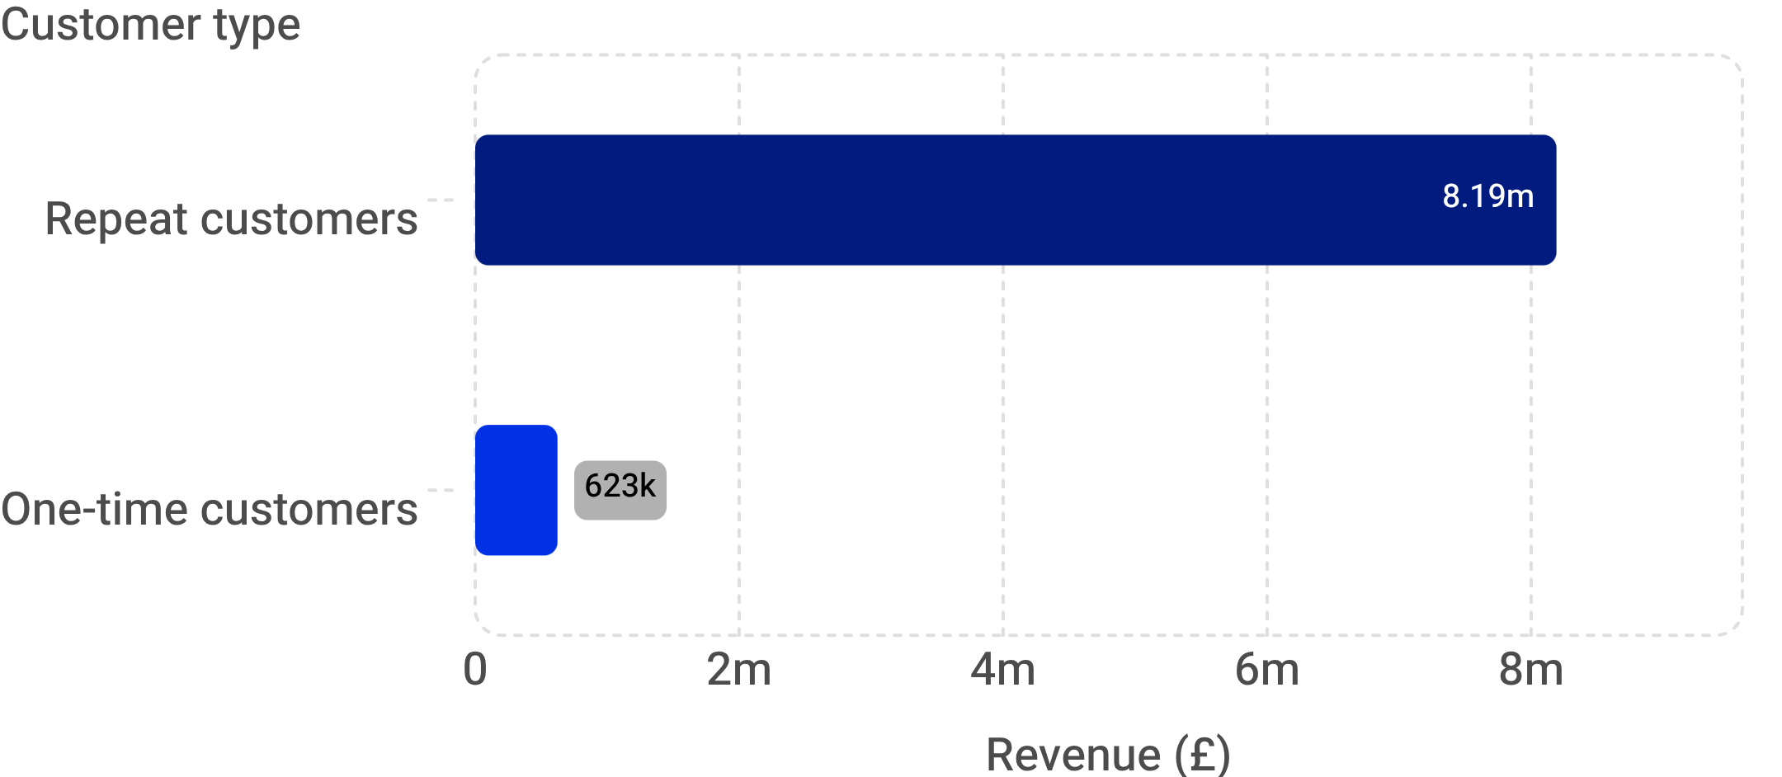
DEEP-DIVE INSIGHT
Repeat purchasing is the clearest value lever in the dataset
WHAT IT MEANS
Protect the repeat-purchase journey first.
2,837 of 4,338 identified customers placed more than one order.
The top 10 customers contributed 17.3% of clean product sales, suggesting value is broader than a tiny account set.
Management action: build retention and replenishment tests before scaling broad acquisition.
Repeat customers contributed £8.19M versus £0.62M from one-time customers among identified customers.

Slide 5
RECOMMENDATIONS
Prioritize retention, selective growth, product focus, and better planning
Retain
Scale winners
Fix the tail
Test regions
Plan demand
Trigger post-purchase follow-up and replenishment journeys for high-value customers.
Prioritize high-performing products and test bundles around proven product families.
Review low-performing products, cancellations, and avoidable operational leakage.
Protect the UK core; test selected non-UK markets on repeat rate and contribution.
Use monthly seasonality and product demand to improve inventory and sales planning.

Slide 6
EXPECTED BUSINESS IMPACT
Measure whether the recommendations create more valuable, repeatable growth
Revenue
Average order value
Retention
Track clean sales and repeat-customer revenue.
Target: [Target %]
Measure basket quality and cross-sell.
Target: [Target %]
Monitor repeat rate and repeat purchases.
Target: [Target %]
Inventory efficiency
Reduce avoidable cancellations and improve demand planning.
Target: [Target %]
90-day scorecard: baseline the measures, run retention and market pilots, then compare results by month and customer cohort.

Slide 7
LIMITATIONS & NEXT STEPS
Use the findings as a decision guide, then deepen the evidence before scaling
What to keep in view
What to do next
135,080 CustomerID values are missing.
5,268 duplicate records were identified.
No profit or margin information is available.
Customer satisfaction and campaign data are unavailable.
Historical data may not reflect current market conditions.
Build profitability and customer-segmentation views.
Run retention and product-bundling analysis.
Test marketing effectiveness.
Create an interactive management dashboard.
Decision guide: protect retention in the UK core, test selective international growth, and scale only after the evidence deepens.

